Slide 1
External Sorting
外排序
SUN YAT-SEN UNIVERSITY

Slide 2
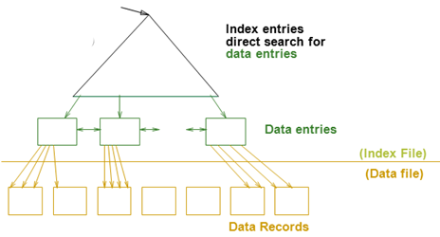
Review
Cost Model（代价模型）
  只关心磁盘块的IO次数
文件由页组成，而每个页包含一组记录
  Record id = <page id, slot #>
索引文件由两部份组成
  数据项部分
    Data Entry(数据项) data record（数据记录）
  引导部份
    树索引技术
    Hash索引
索引的 clustered？

Slide 3
Why External Sorting(外排序)?
Problem: sort 100Gb of data with 1Gb of RAM.
  why not virtual memory?
Idea
  方法:对数据进行多遍处理,
  效果:从而可以使用较少内存排序庞大的数据集
Notes:
4

Slide 4
Two-Way External Merge Sort: Requires 3 Buffers
两路归并外排序
Pass 0(生成有序段/子文件): Read a page, sort it, write it.
  each sorted page (or subfiles) is called a run(有序段).
  only 1 buffer page is used.
Pass 1, 2, 3, …, etc.(合并有序段):
  merge pairs of runs into runs twice as long 有序段长加倍
  3 buffer pages used
8,7
7,8
INPUT 1
OUTPUT
INPUT 2
Main memory buffers
Disk
Disk
Merging Runs(合并有序段)
Notes:
5

Slide 5
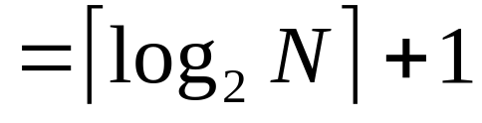
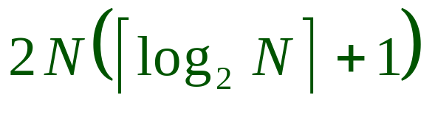
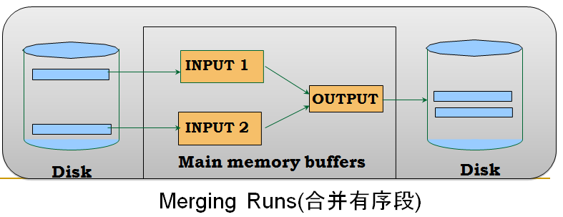
Two-Way External Merge Sort: Requires 3 Buffers
两路归并外排序
Each pass(每遍) we read + write each page in file.
N pages in the file => the number of passes
So total cost is:
3,4
6,2
9,4
8,7
5,6
3,1
2
Input file
PASS 0
3,4
2,6
4,9
7,8
5,6
1,3
2
1-page runs
PASS 1
2,3
4,7
1,3
2-page runs
4,6
8,9
5,6
2
PASS 2
2,3
4,4
1,2
4-page runs
6,7
3,5
8,9
6
PASS 3
1,2
2,3
3,4
8-page runs
4,5
6,6
7,8
9
Notes:
6

Slide 6
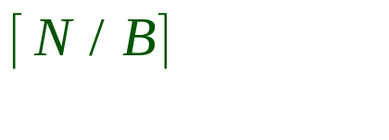
General External Merge Sort
外归并排序
More than 3 buffer pages. How can we utilize them?
To sort a file with N pages using B buffer pages:
  Pass 0: use B buffer pages. Produce sorted runs of B pages each.
  Pass 1, 2, …, etc.: merge B-1 runs.
INPUT 1
. . .
INPUT 2
. . .
. . .
OUTPUT
INPUT B-1
Disk
Disk
B Main memory buffers
Merging Runs
Notes:
7

Slide 7

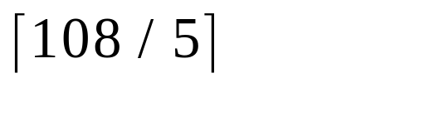
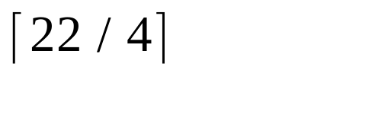
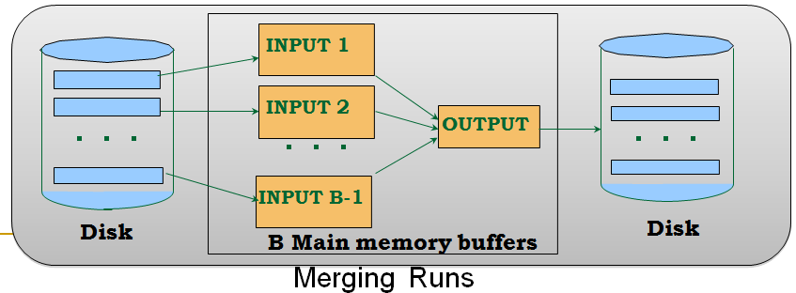
Cost of External Merge Sort
Number of passes:
Cost = 2N * (# of passes)
E.g., with 5 buffer pages, to sort 108 page file:
  Pass 0: = 22 sorted runs of 5 pages each (last run is only 3 pages)
  Pass 1: = 6 sorted runs of 20 pages each (last run is only 8 pages)
  Pass 2: 2 sorted runs, 80 pages and 28 pages
  Pass 3: Sorted file of 108 pages
Formula check: ┌log₄ 22┐= 3 … + 1 → 4 passes √
Notes:
8

Slide 8
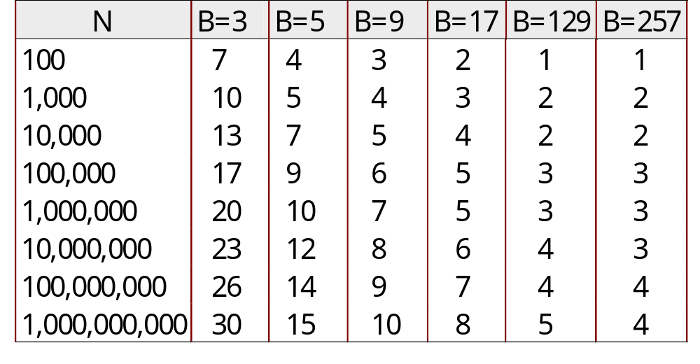
Number of Passes of External Sort
缓冲区越多,处理遍数越少
( I/O cost is 2N times number of passes)
In practice, most files sorted in 2-3 passes
Notes:
9

Slide 9
Summary, cont.
Choice of internal sort algorithm may matter:
  Quicksort: Quick!
  Heap/tournament(树形选择排序) sort
Clustered B+ tree is good for sorting; unclustered tree is usually very bad.
要求:
  掌握外排序算法
  理解并记住外排序IO开销的基本公式
Cost = 2N * ( # of passes)
Notes:
19

